Slide 1
Charleston Tech
Alex Castelli email: alex@charlestondigitalcorridor.com

Slide 2
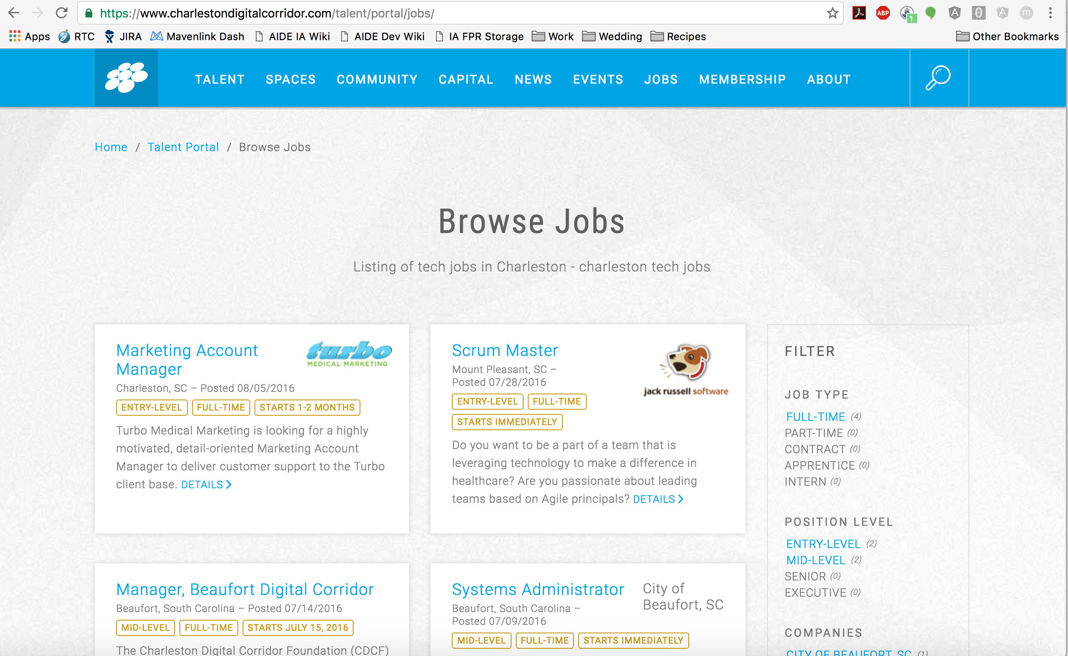
Jobs
Charleston Digital Corridor
Notes:
Also has Talent section

Slide 3
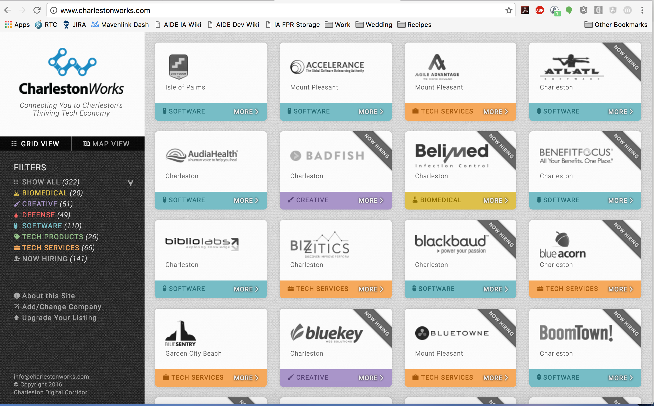
Jobs
CharlestonWorks

Slide 4
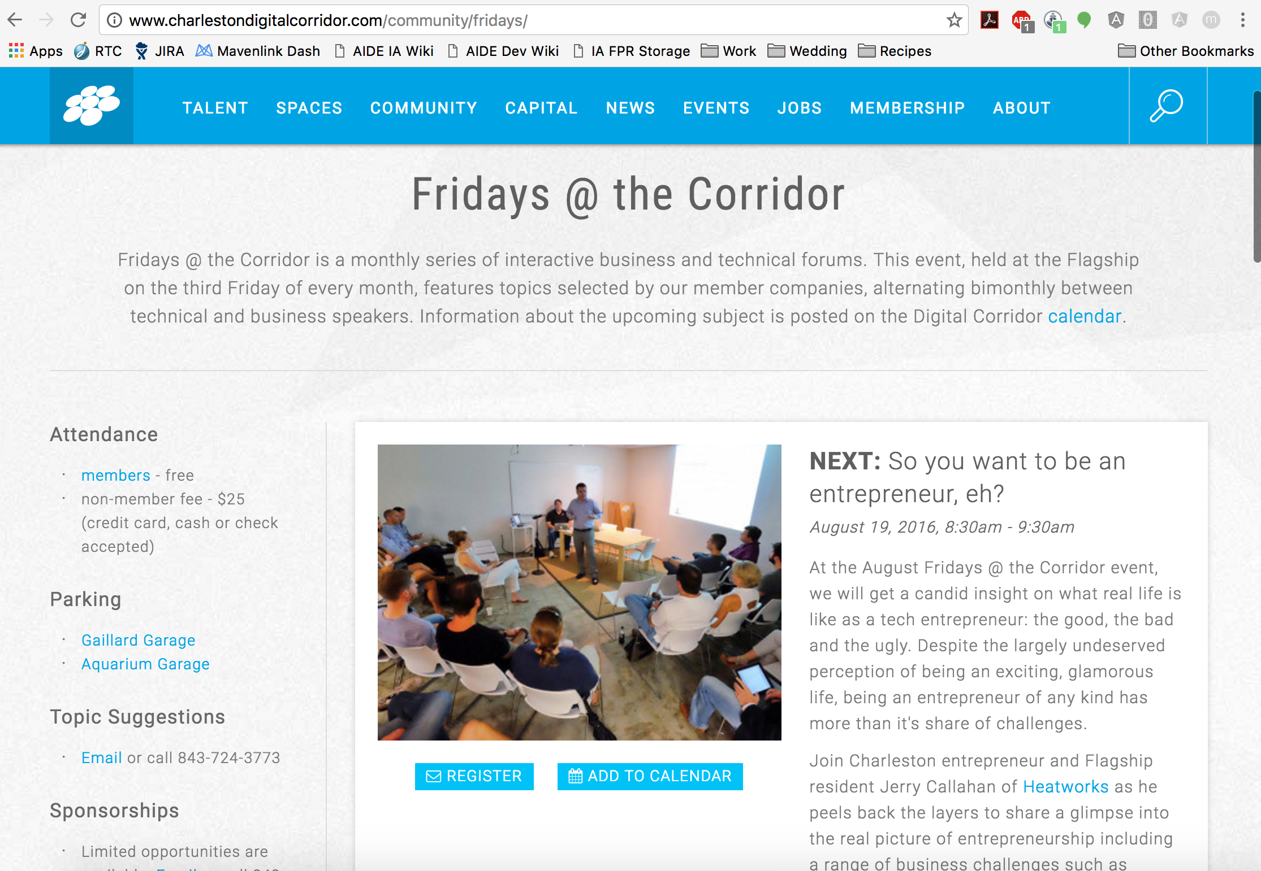
Continuing Education
Fridays at the Corridor

Slide 5
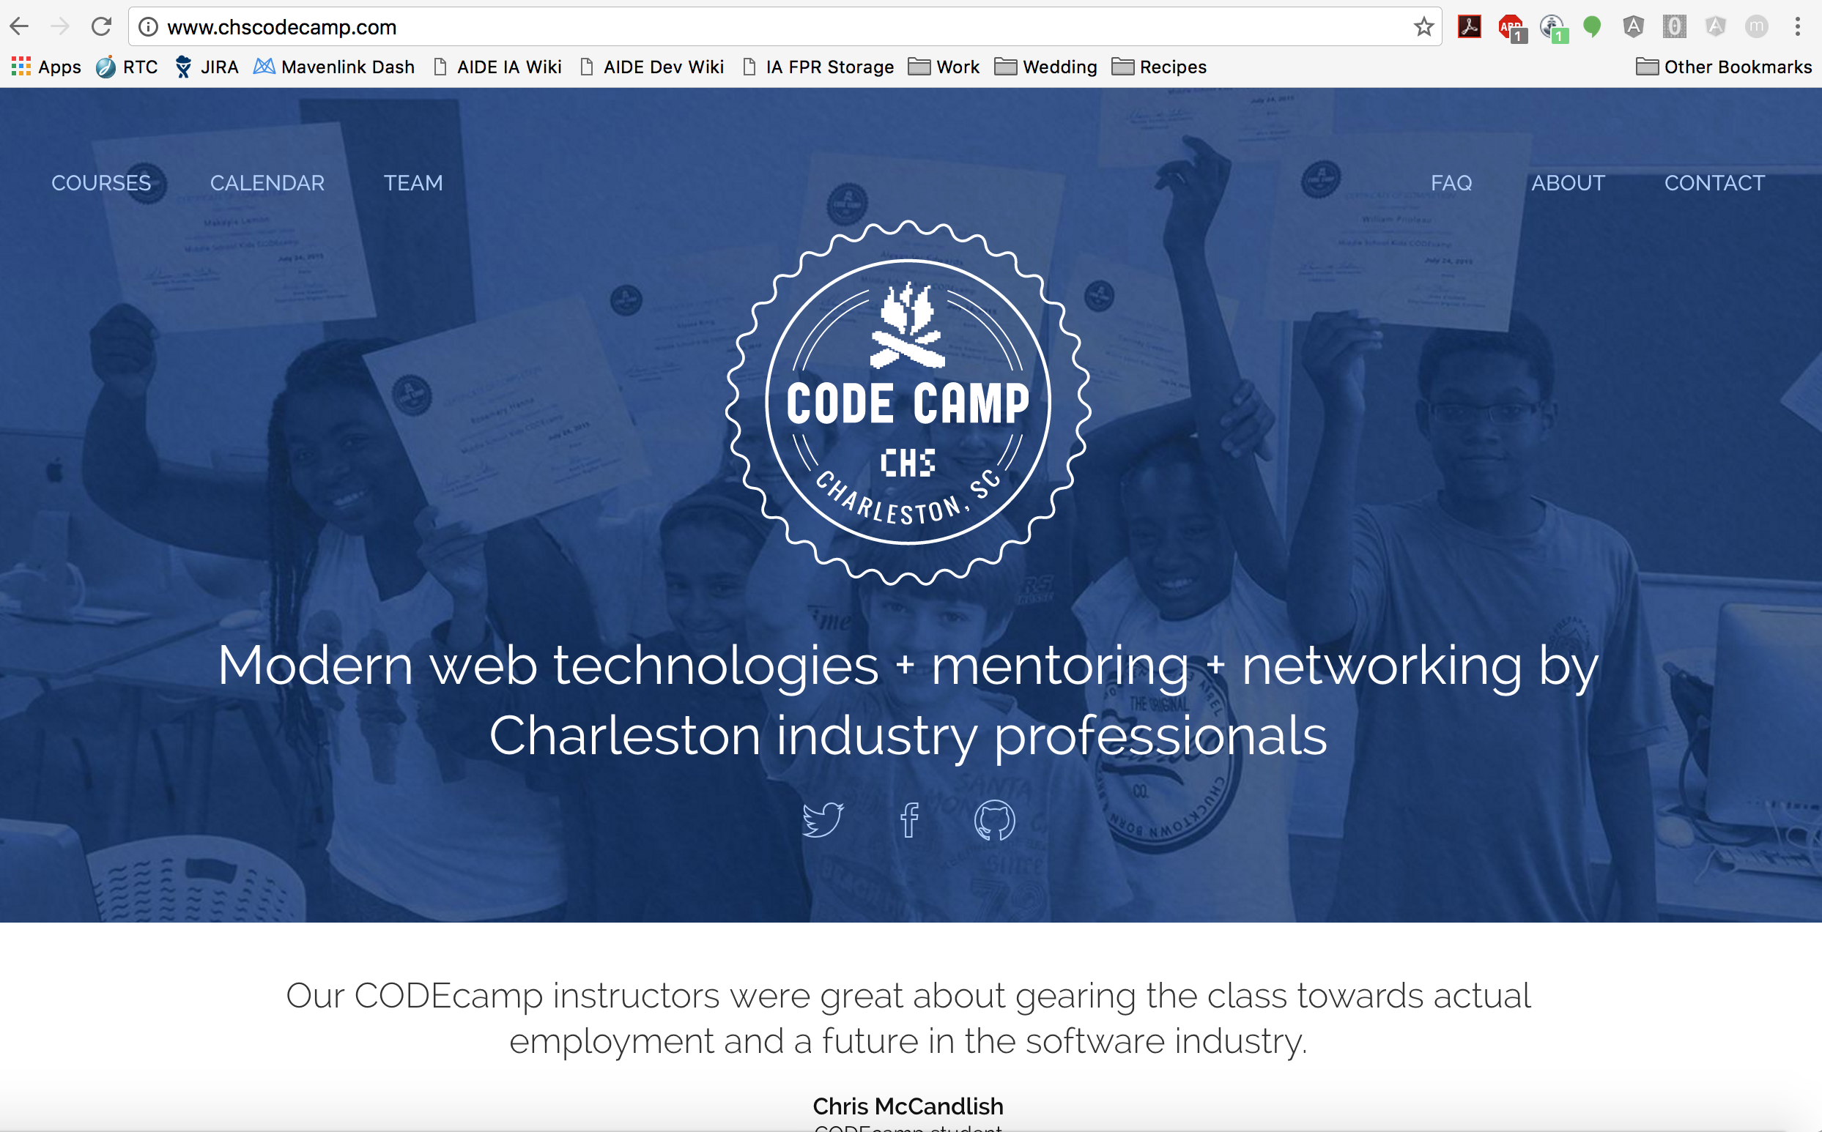
Continuing Education
CODEcamp

Slide 6
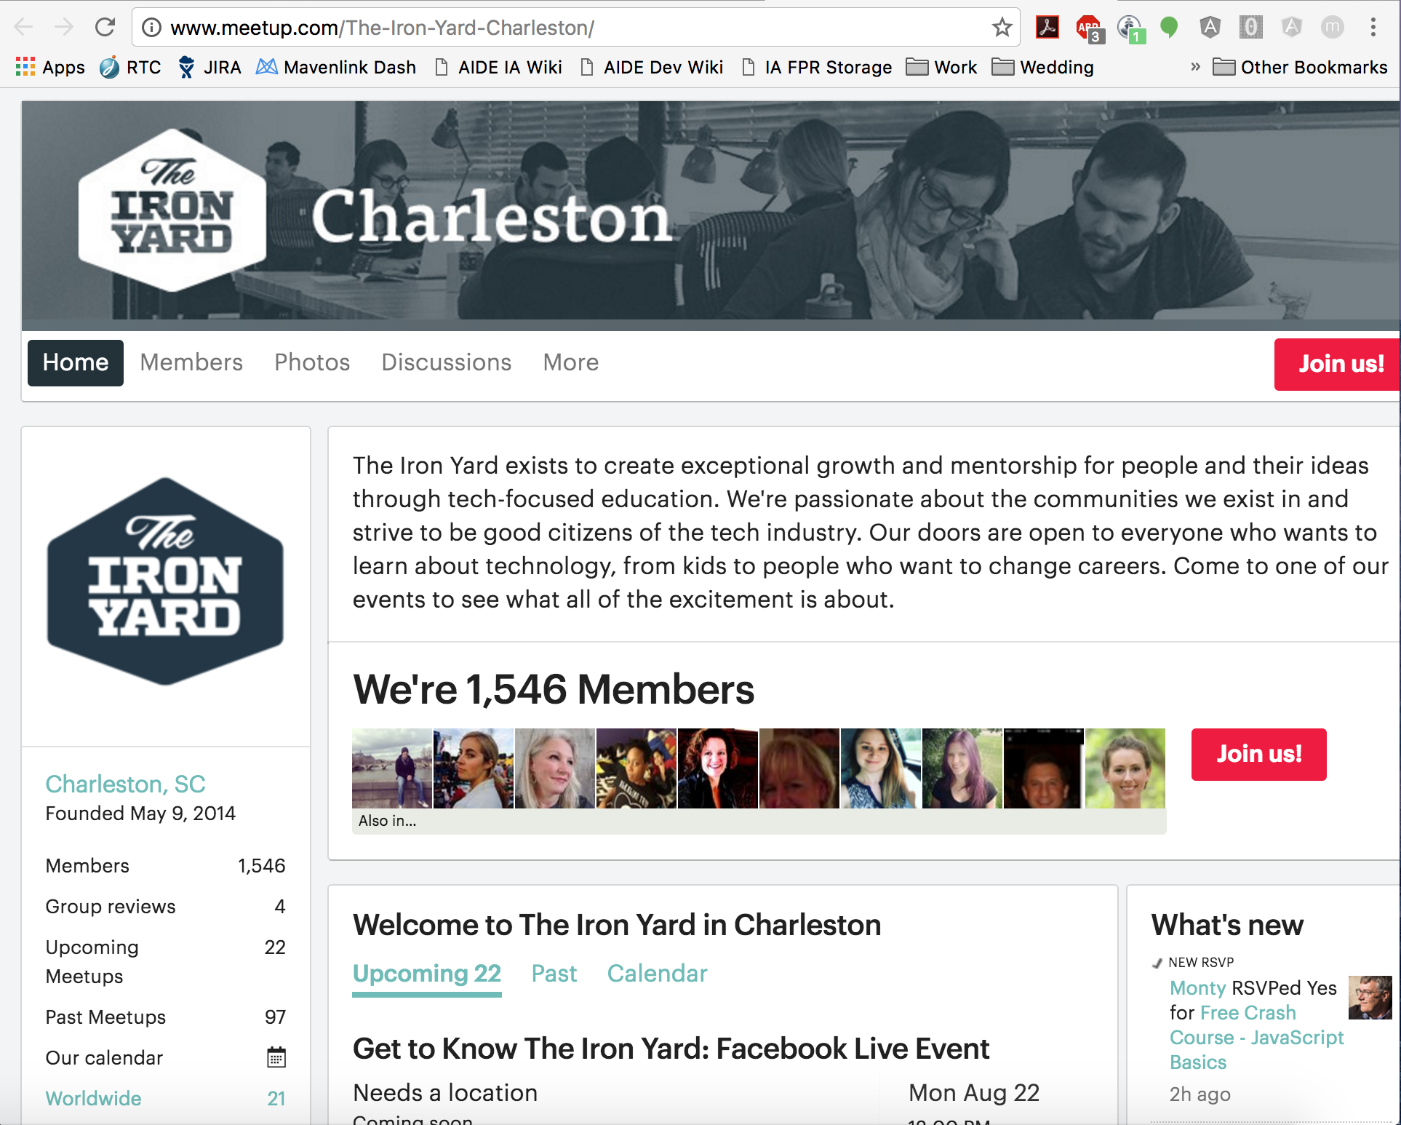
Continuing Education
Iron Yard Free Courses

Slide 7
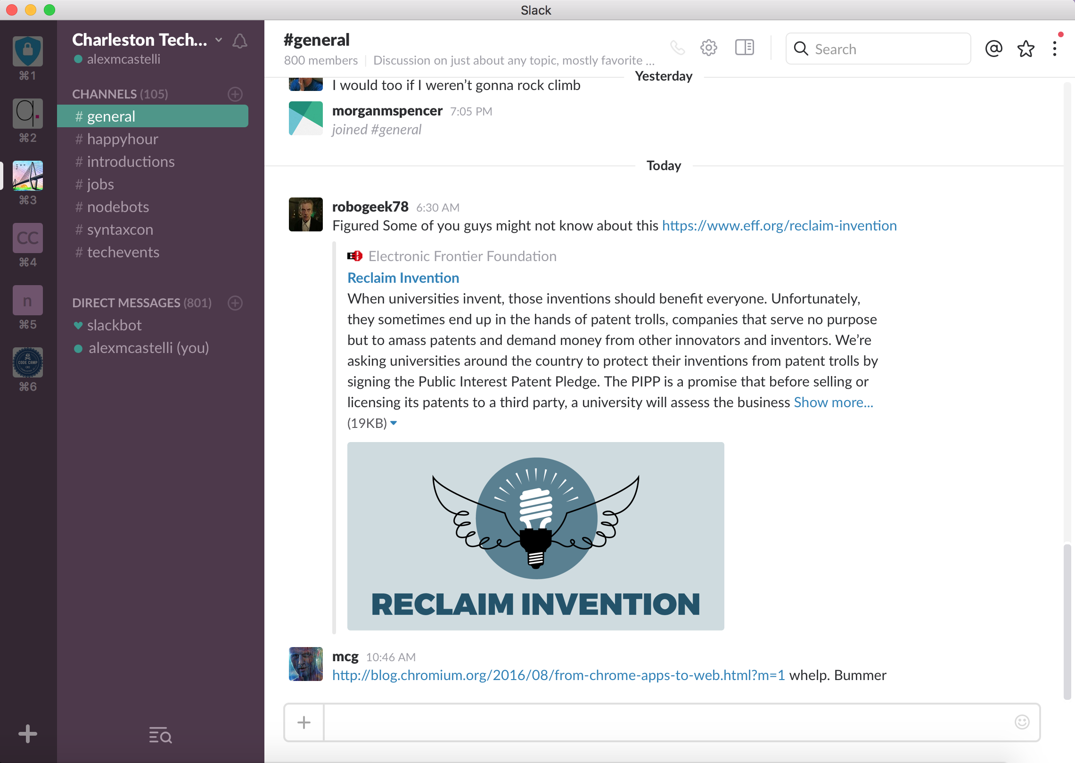
Connect
Charleston Tech Slack
Invite Link: http://charlestontechslack.herokuapp.com/

Slide 8
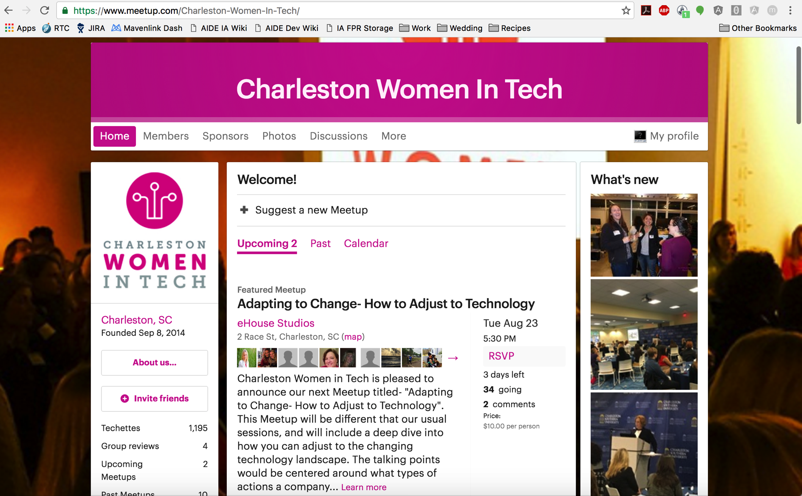
Connect
Charleston Women in Tech (WIT)

Slide 9
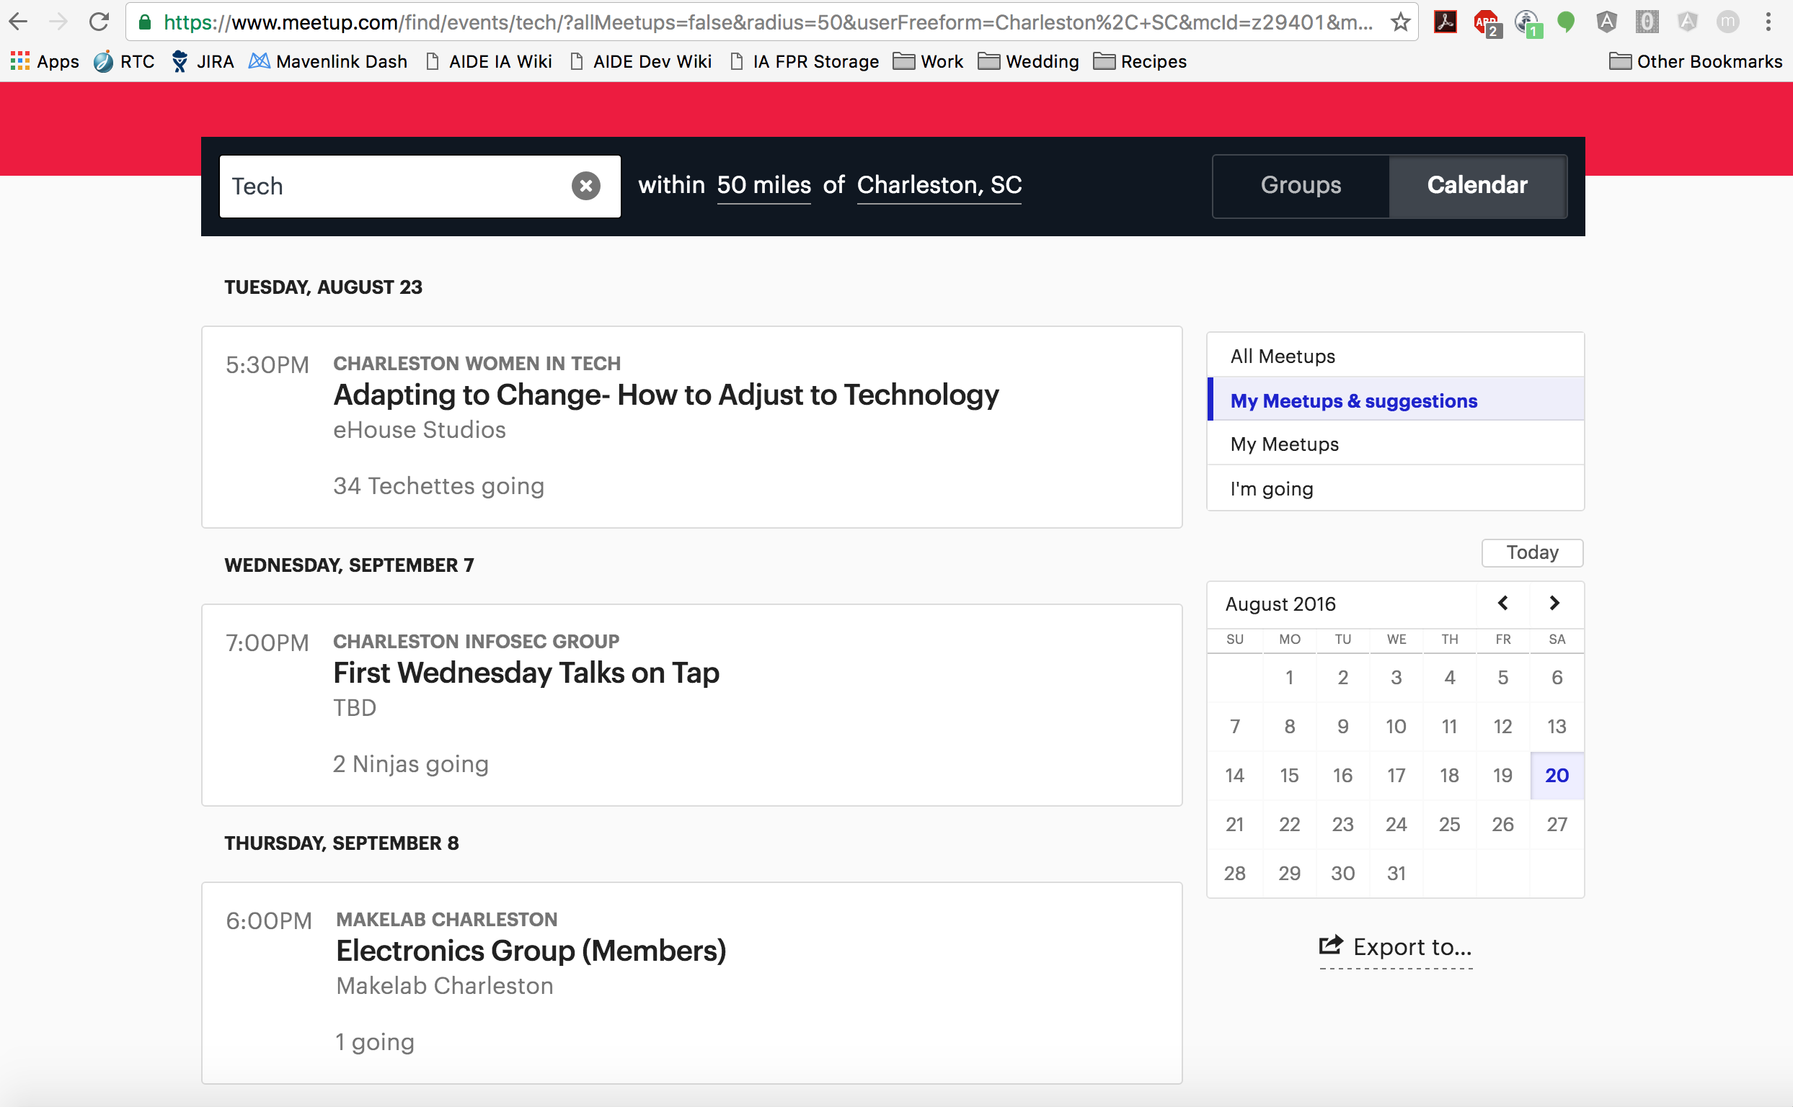
Connect
Charleston Tech Meetup Groups

Slide 10
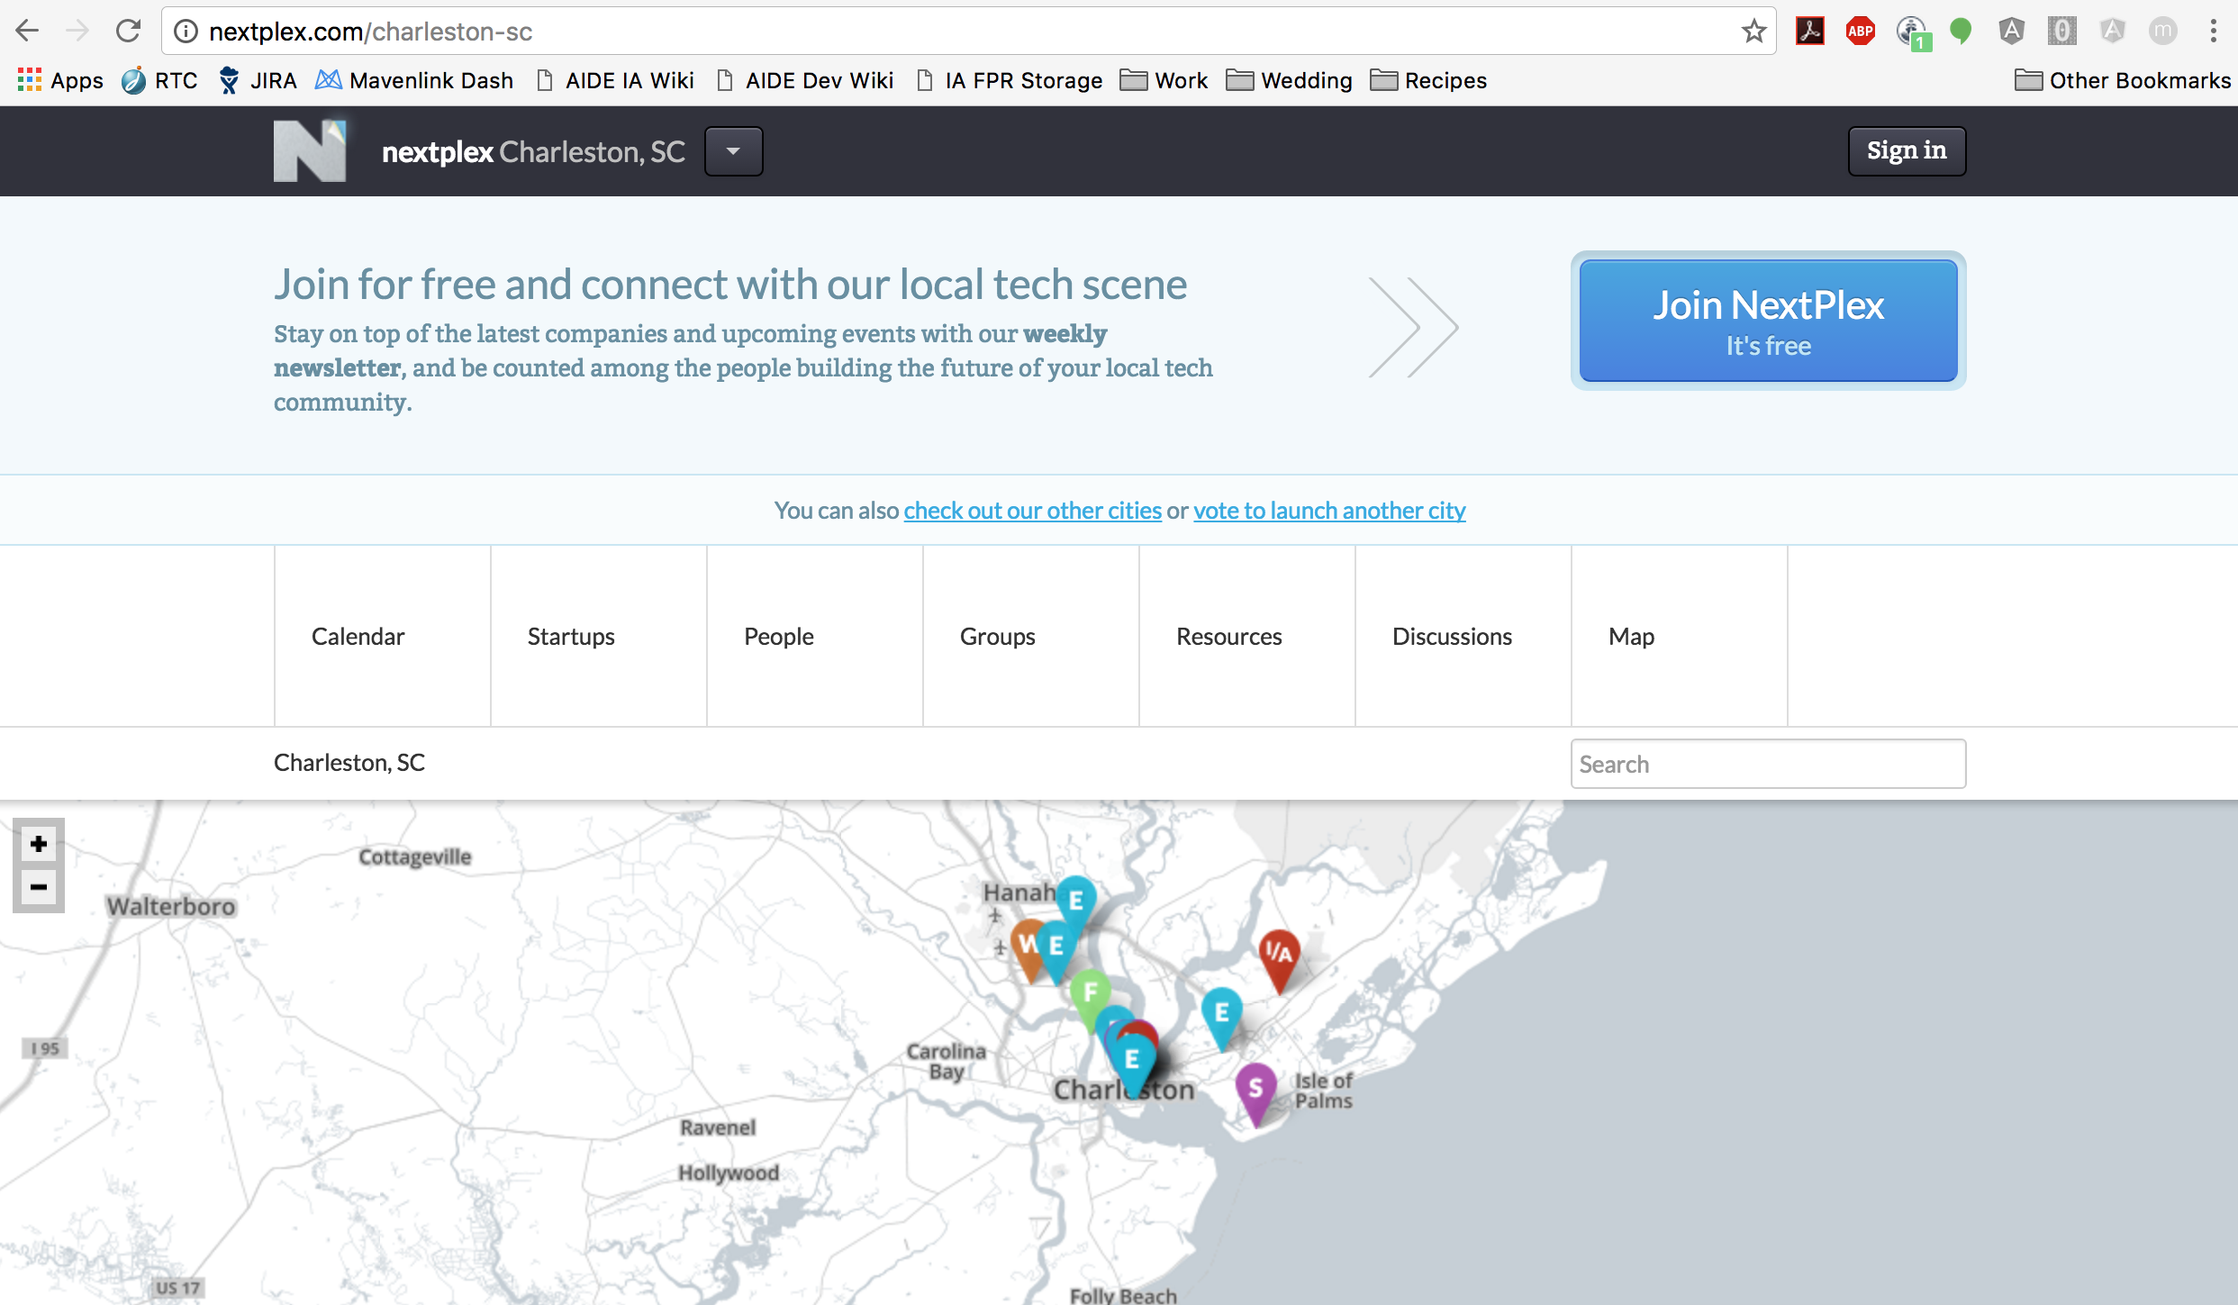
Connect
NextPlex

Slide 11
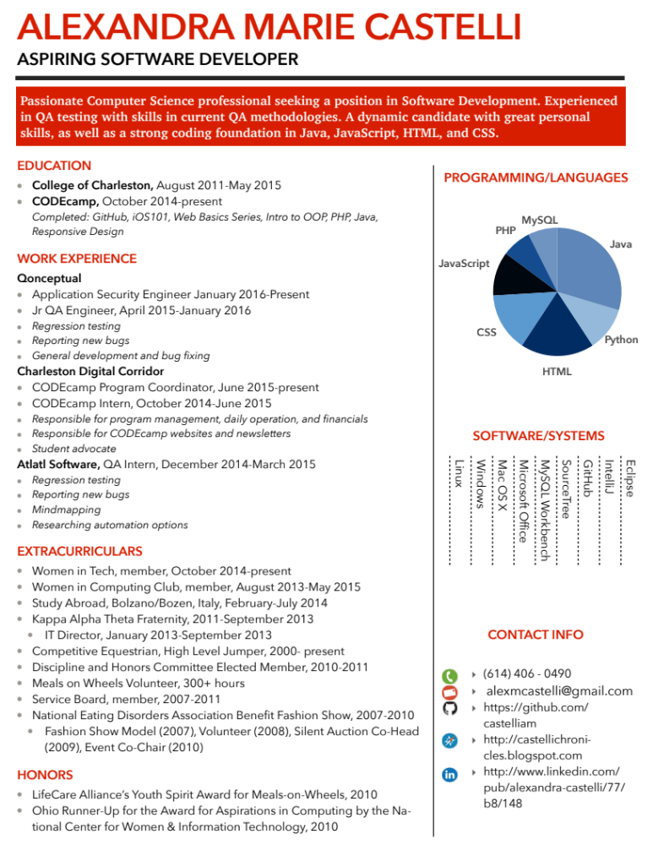
Resumes/Interviewing
Company Culture
Apply A LOT and early
Internships
Interesting Resume
Use CofC Resources
GitHub
Keep 362 and 462 Projects!!!

Slide 12
Resume Sites
Robby Leonardi
Project Euler
FreeCodeCamp

Slide 13
Example Interview Questions
https://www.glassdoor.com/Interview/entry-level-software-engineer-interview-questions-SRCH_KO0,29.htm
http://www.techrepublic.com/blog/10-things/10-things-you-may-be-asked-during-a-developer-interview-and-how-to-handle-them/
http://noop.nl/2009/01/100-interview-questions-for-software-developers.html

Slide 14
Any questions?

